Slide 1

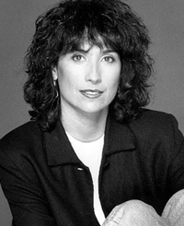

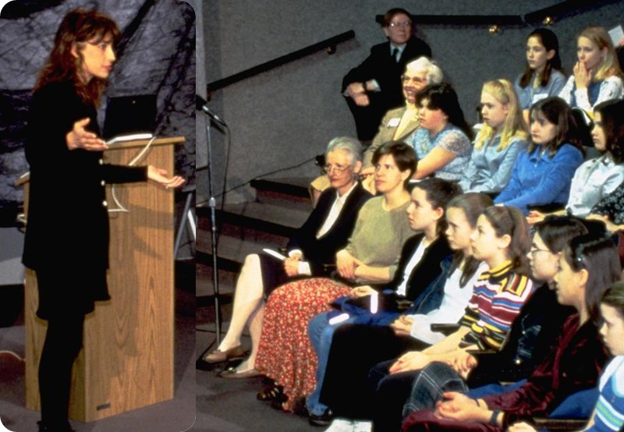
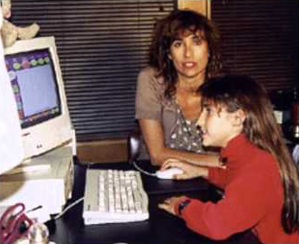
Women
Janese Swanson
To change pictures:
Save the picture of the person you wish to use.
Single-left-click the grouped picture/shapes you wish to change on the poster. Single-left-click again on the picture.
Now single-right-click the picture and select “Change Picture” from the menu.
Choose the picture file you saved.
You may wish to single-left-click the grouped picture/shapes and single-left-click the new picture again to adjust its size or crop it—especially useful if the new picture is not the same aspect ratio as the previous one.
DO NOT CHANGE ROSIE THE RIVETER PICTURE!!!
In Technology
1975 Youngest & only female electronics salesperson at Sears, became top seller
1980s Used donated laptops to teach fellow flight attendants computer use
1992 Founded Kid One For Fun
1995 Founded Girl Tech
Instrumental in the development of Where in the World is Carmen San Diego and the Playroom/Treehouse series. She invented a line of electronic gadgets that empower girls to use technology. In the process, Swanson has challenged attitudes towards girls in the toy and consumer products industries.
As a young girl, I was interested in technology in many forms. One year, for example, I received a typewriter as a gift. I played around with typing, tried out some of the exercises, and soon decided it was boring. It would be much more interesting, I thought, to take the machine apart and see for myself how it worked. So I did, and I figured it out and changed the keys around so I could type in my own secret code.
What paths will you trailblaze that no one has traveled before?

